Slide 1


Clemson Capstone Migration Proposal

Slide 2
What Problem Are We Facing?
And what will we do about it?

Slide 3
Problem Summary
Michelin uses a legacy COBOL ERP which is outdated and antiquated
The goal is to migrate to a newer Java based system, Oracle EBS
In the legacy system there is business logic embedded which reflects special conditions of certain clients which needs to be preserved
We need to make a product which can handle this migration while maintaining this business logic so that the new system correctly generates invoices

Slide 4
The Proposal

Slide 5
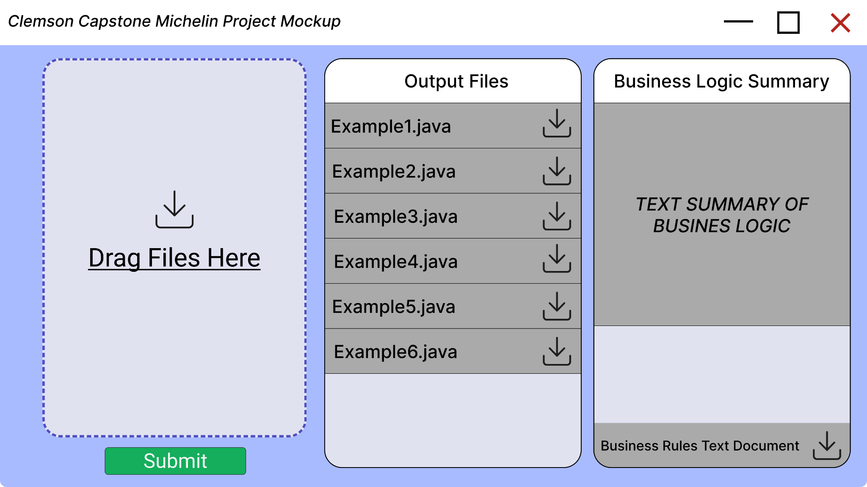
Initial Mockup
Provide text based summary and file output of derived business logic
Multiple COBOL file inputs
Generate the necessary java files to be used in the Oracle system

Slide 6
TIMING
Phase 2
Phase 4
Develop a Framework While Data Gathering
Implementation and Beta Testing
Phase 1
Phase 3
Researching existing solutions
Development and Alpha Testing

Slide 7
Phase 1 & Needs
Research RAG and other methods of generation and decide which is the most applicable
Determine what existing model we want to base the product on
Llama 2, CodeBERT, other
Research COBOL analyzers and parsers and determine how we can deconstruct COBOL
PARTNER INPUT:
What are the solutions already explored by Michelin? Is there any documentation explaining how far it got?
What does the current system look like?
What was the process and end product of migrating Ordering & Invoicing?

Slide 8
Phase 1 Timeline
Michelin Action Items
Capstone Action Items
9/23: Deliver COBOL, Ordering and Invoicing documentation as well as any technologies/approaches already attempted or in progress
9/27: Analyze provided documentation and continue current research to fully understand the current state and gather a list of potential approaches
10/4: Deliver final report on our chosen methodology including the technology we intended to implement during the course of development

Slide 9
Questions?

